Slide 1
Green Leaf The Smile
Team members
An Eui Hyun
Alabdulwahab Abrar
Jamshid Khaytbaev

Slide 2
Fake it till you make it

Slide 3




Background
Through The Day
Start Your Day ~

Slide 4



Background

Slide 5
Concepts

Slide 6







Forecast
Tu: Rainy☔
Tu :Rainy☔
Tu :Rainy☔
Picture Time
Smile
Schedule:
Do the PPT
Do the PPT
Do the PPT

Slide 7





















Slide 8
Hardware Design

Slide 9
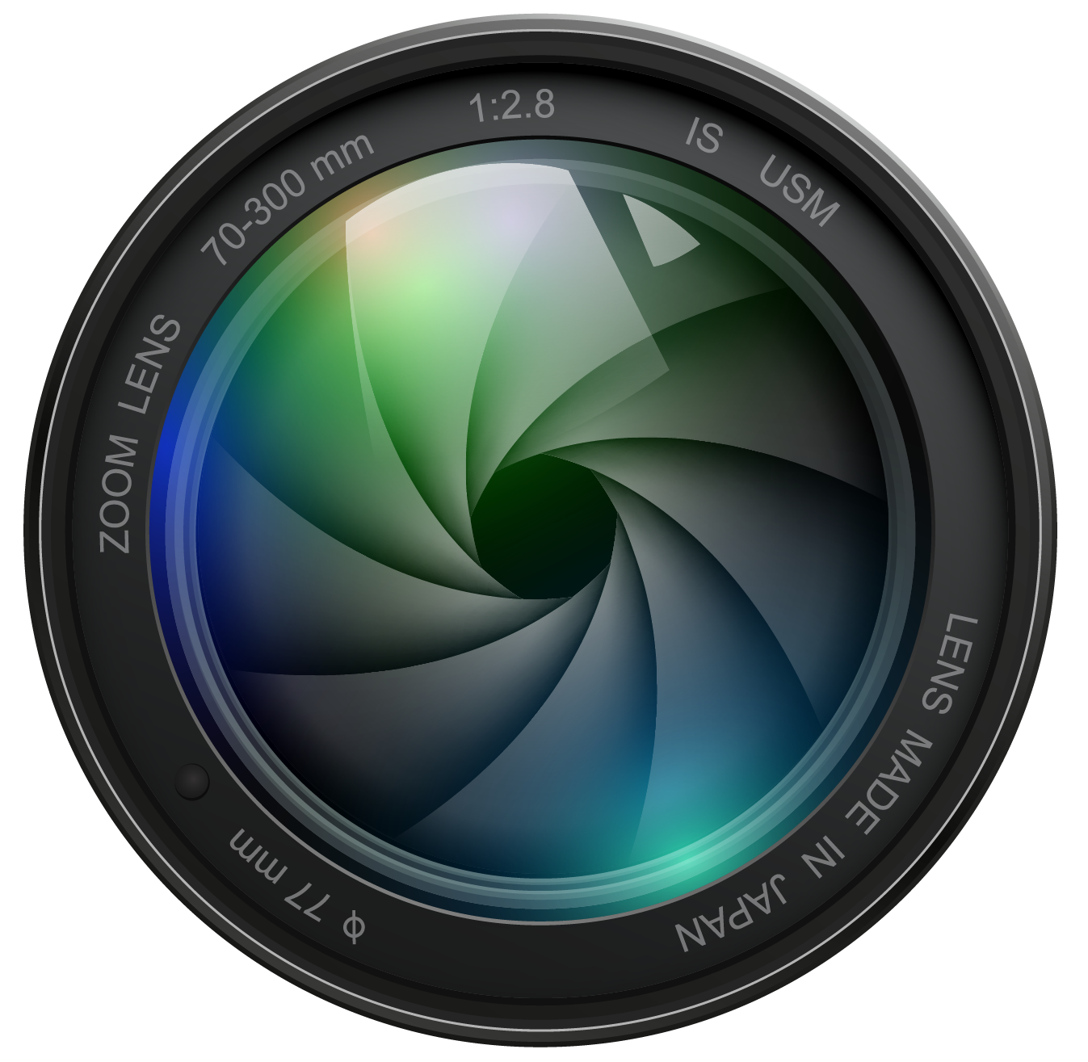
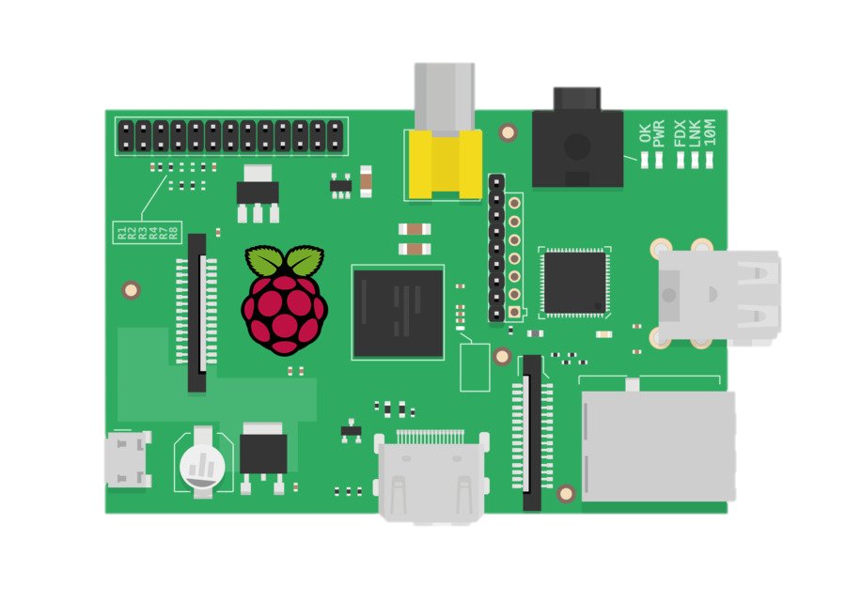
Design
Raspberry pi
Camera
Monitor
Glass
Mirror
Frame

Slide 10
Design

Slide 11
Design
Smart Mirror

Slide 12
Graphic Design

Slide 13
Wednesday, September 22,2021
12:28
_____________________________
Columbus Day
Halloween
Veterans Day
Thanksgiving Day
Christmas
Holidays
Oct 11th
Oct 31st
Nov 11th
Nov 25th
Dec 25th
You are The Best
Hey Handsome
You Look Good

Slide 14



Graphic Design

Slide 15
The Magic Mirror

Slide 16
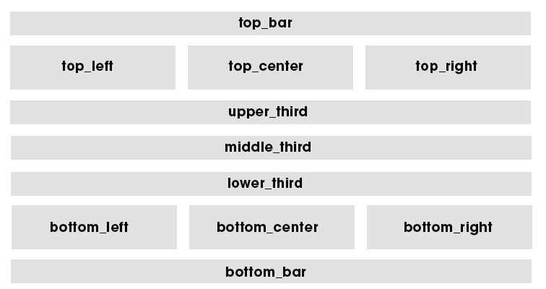

Slide 17
Go to our Pi Command

Slide 18
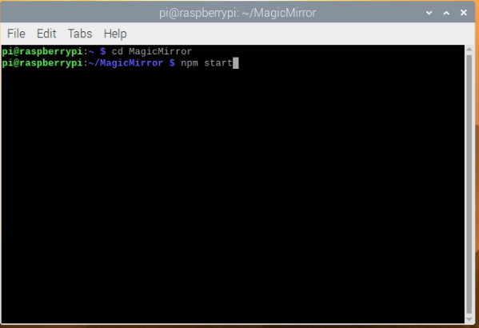

Slide 19
We can see the layout in action

Slide 20
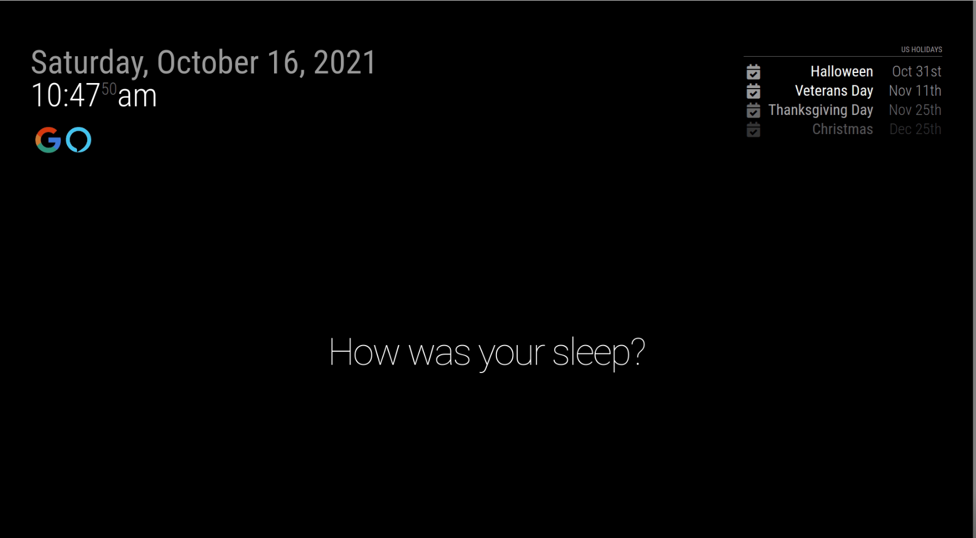

Slide 21
Default Modules

Slide 22

{
module:“alert“,
},
{
module:"updatenotification“,
},
{
module:"clock“,
},
{
module:“calendar“,
},
{
module:"compliments “,
},
Default

Slide 23
Installed Modules

Slide 24


{
module: "MMM-Detector",
position: "top_left",
configDeepMerge: true,
config: {
debug: false,
}
MMM-Detector
module:"MMM-GoogleAssistant",
position: "bottom_bar",
configDeepMerge: true,
MMM-GoogleAssistant

Slide 25
Google Assistant

Slide 26
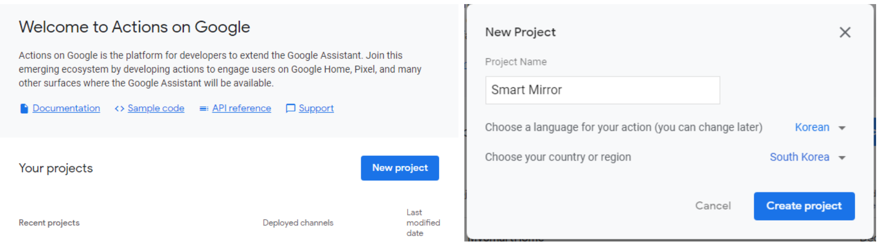
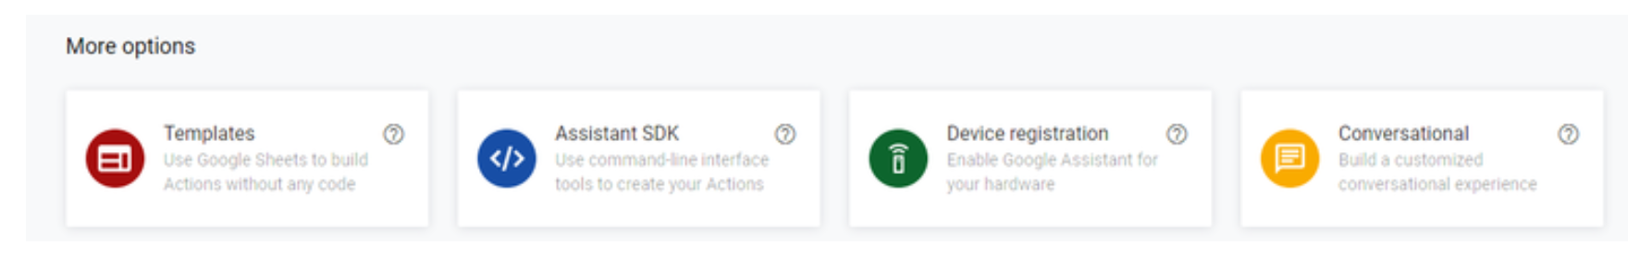

Slide 27
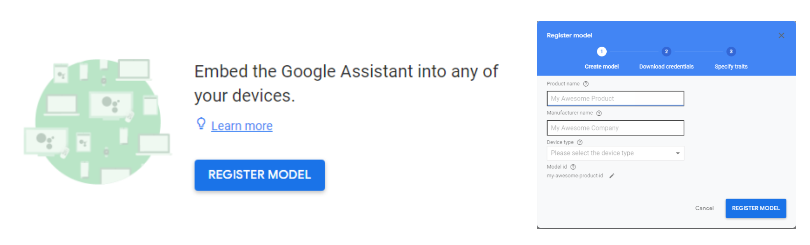

Slide 28
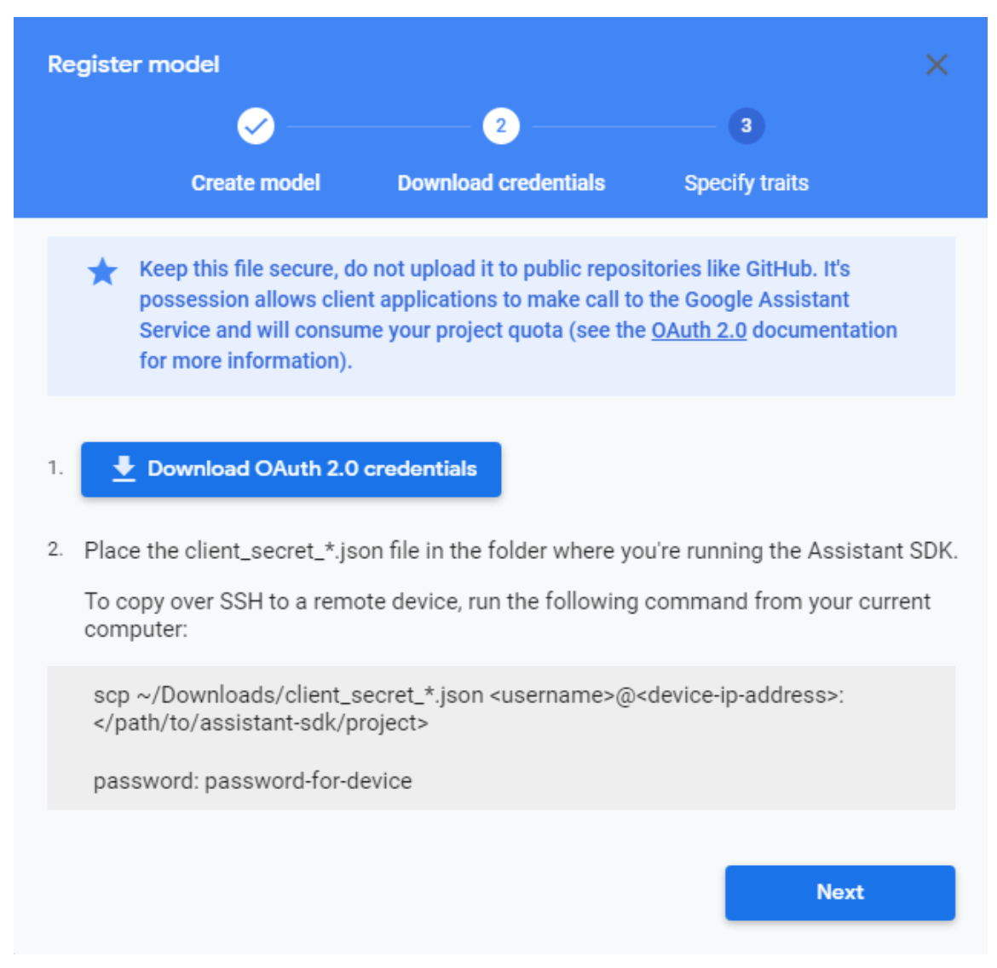
Change the name
Credentials.json

Slide 29
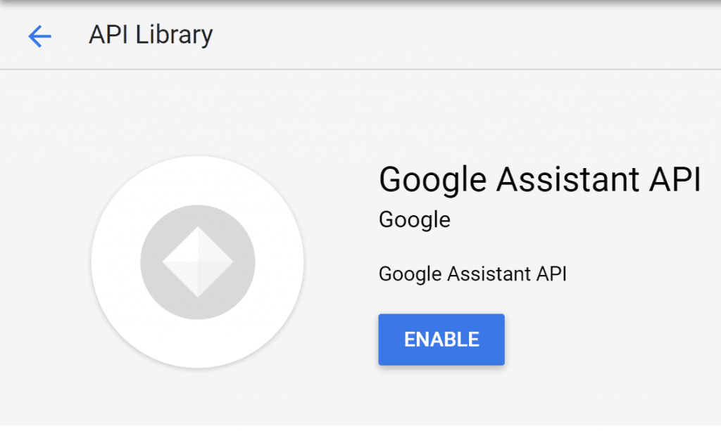

Slide 30
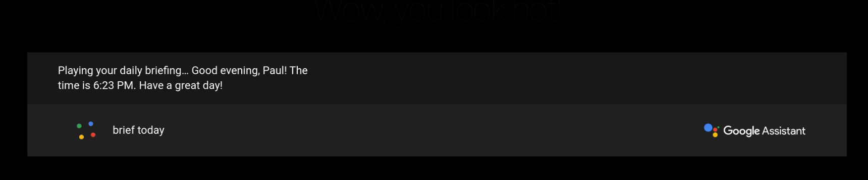

Slide 31
Adding Calendar Events

Slide 32
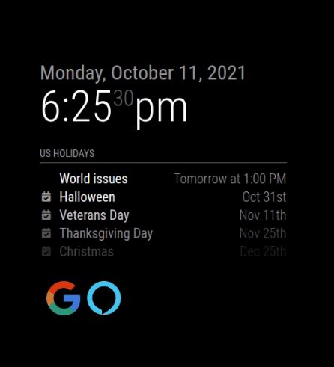
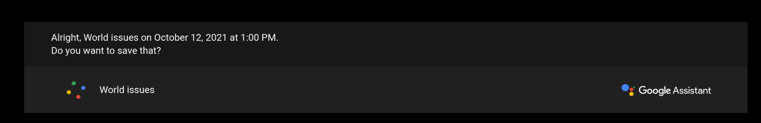

Slide 33
Compliments

Slide 35
Smile Camera

Slide 36

Smile
main.py
cap = cv2.VideoCapture(1) face_cascade = cv2.CascadeClassifier('haarcascade_frontalface_default.xml') smile_cascade = cv2.CascadeClassifier('haarcascade_smile.xml')
haarcascade_smile.xml
for x, y, w, h in face: cv2.rectangle(frame, (x, y), (x + w, y + h), (0, 255, 255), 2) face_roi = frame[y:y + h, x:x + w] gray_roi = gray[y:y + h, x:x + w] smile = smile_cascade.detectMultiScale(gray_roi, 1.3, 25) for x1, y1, w1, h1 in smile: cv2.rectangle(face_roi, (x1, y1), (x1 + w1, y1 + h1), (0, 0, 255), 2) cv2.imwrite('sel.png', original_frame) mail_content = '''Thank you for smiling,
haarcascade_frontalface_default.xml
sel.png

Slide 37



Automated Email
Hardware
Combine
Sending Emails
Wednesday, September 22,2021
12:28
____________________________
Columbus Day
Halloween
Veterans Day
Thanksgiving Day
Christmas
Holidays
Oct 11th
Oct 31st
Nov 11th
Nov 25th
Dec 25th

Slide 38
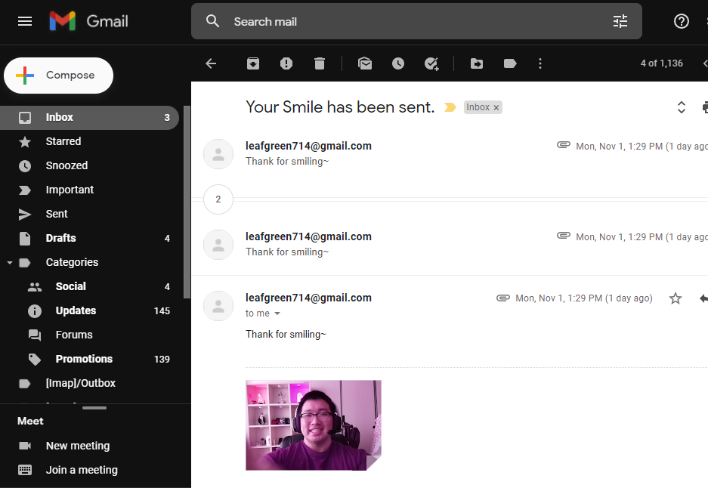

Slide 39


Assigning the Roles
Abrar Alabdulwahab
Jamshid
Khaytbaev
An Eui Hyun
PPT
Add to open source
Face recognition code
Team Leader
Test /fix the open source
Face recognition code
Making hardware
Research open source
Face recognition code
Research automated emails

Slide 40
Thank You~

